Slide 1

RECLAMATION OF COMPUTING WASTE HEAT - USED AS A HEATING SOURCE AT CAMPUSES
TEAM : C CUBED

Slide 2
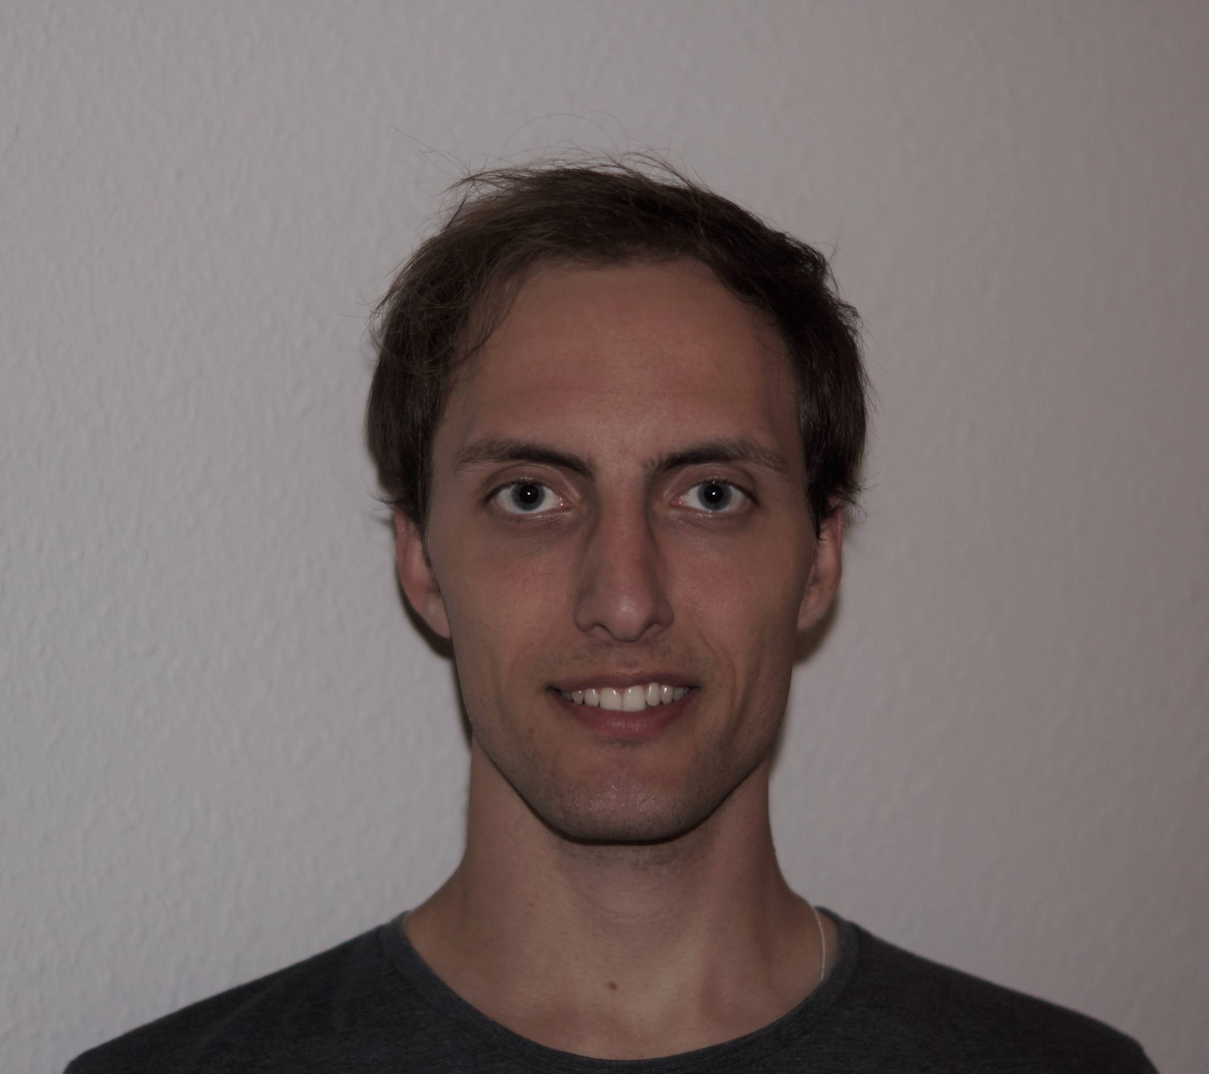

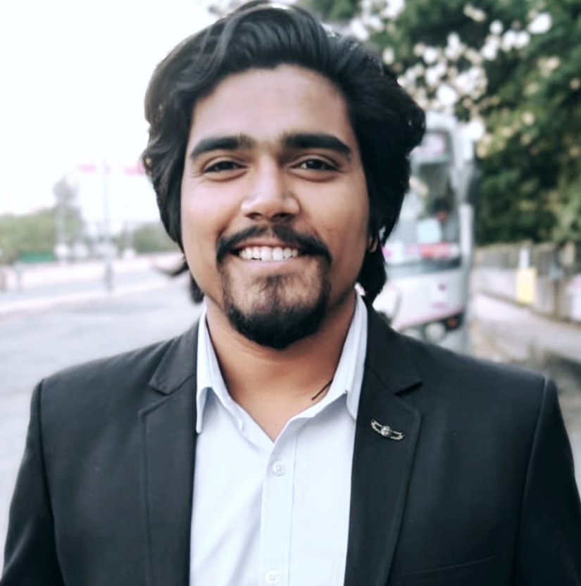
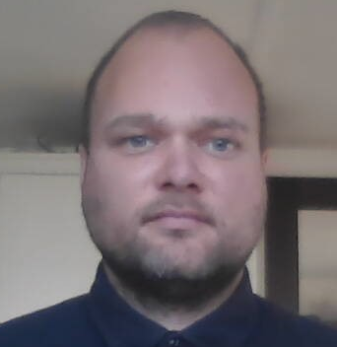

C CUBED TEAM MEMBERS
Anders Leth
Brajesh
Shubham S. Ingole
Søren F. Andersen
Naomi Lutz
BSc.
Product Development & Innovation
MSc.
Sustainable energy
MSc.
Business Analytics
MSc.
Environmental Engineering
BSc.
Mechanical Engineering
SDU
DTU
DTU
SDU
MIT

Slide 3

CONCEPTS
Connecting all the laptops to a central servers
Using the waste heat from the data centres for space heating or water

Slide 4
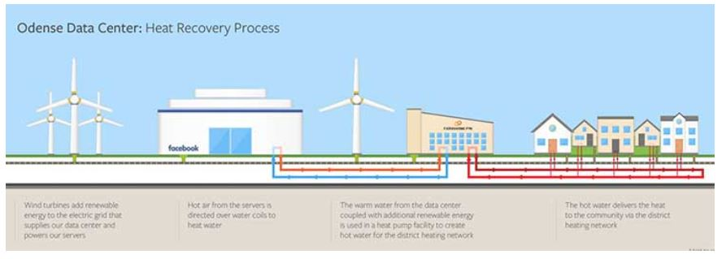
IDEA
Create a centralized computing network for student PCs, saving energy and using the waste heat from servers to heat campus buildings or water.
(picture from: datacenterfrontier.com)

Slide 5
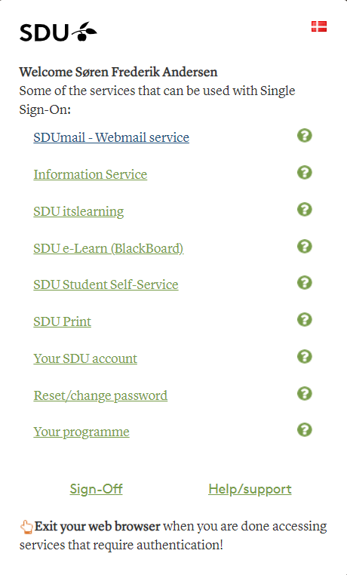



OVERCOMING OBSTACLES
Easy administration
A single, unified login page
Equal access for students to software and programs

Slide 6

SDG
Common access to High performance computing power.
Improving the IT infrastructure.
Less dependency on user hardware upgrades.
Energy recovery from waste heat.

Slide 7




BENEFITS & OUTCOMES
Annual savings of:
More than 450.000 kWh is used annually for student laptops at MIT
267 MWh of electricity
39.840 USD for electricity
192 MWh for heating

Slide 8
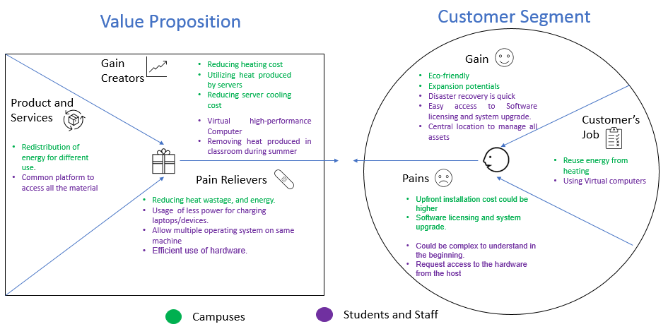
VALUE PROPOSITION

Slide 9
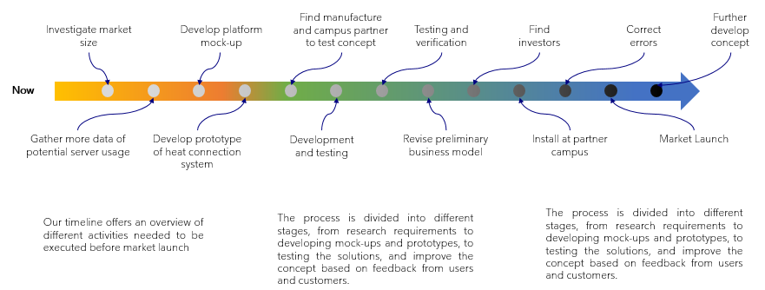
IMPLEMENTATION TIMELINE

Slide 10

Thank You

